Slide 1
Mutations
Changes to DNA

Slide 2

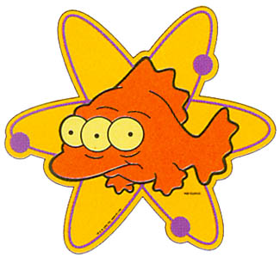
What are Mutations?
Any change to the DNA
Mutations in body (somatic) cells can cause cell death or cancer
Those in germ (sex) cells may be passed on to offspring called mutants.
Mutations may be random (occur spontaneously, e.g. during replication), or be induced by mutagens.

Slide 3
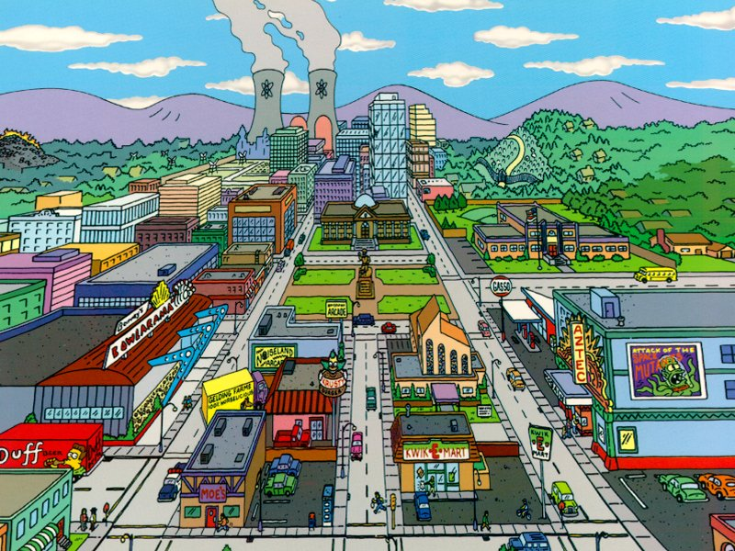
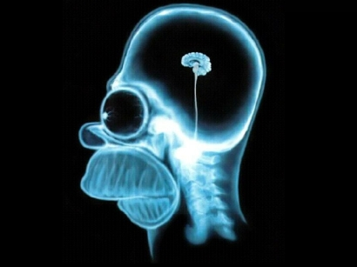

Mutagenic Agents = Mutagens
Ionising radiation – e.g.:
  from nuclear reactions
  Or X-rays
DOH!

Slide 4
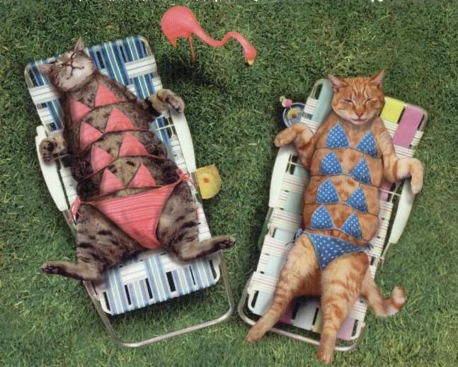


2. Ultra-violet
E.g from sunbathing

Slide 5
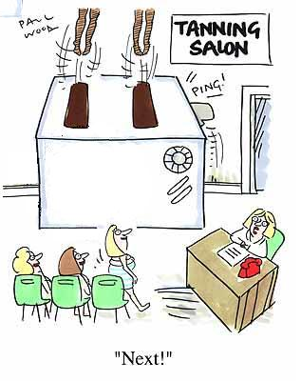
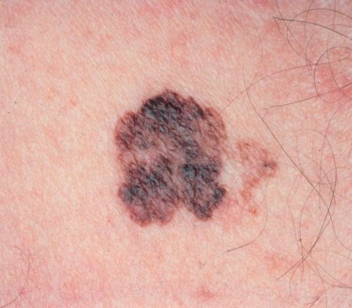
Or Tanning salons…..
With possible consequences
– Mutagens may also be carcinogens!

Slide 6
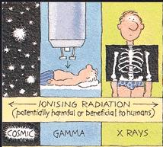
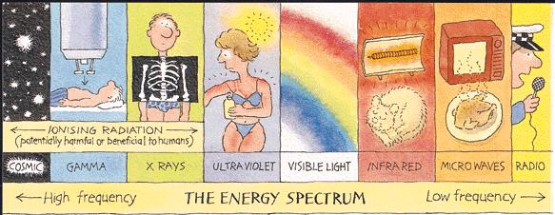

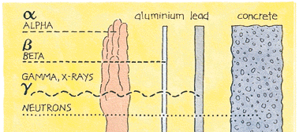
Radiant Energy – who’s who?

Slide 7
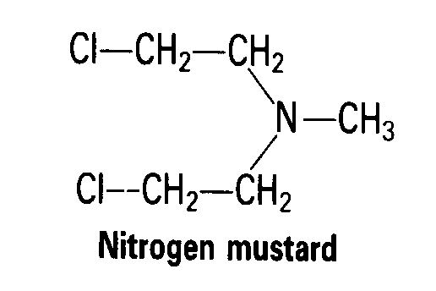
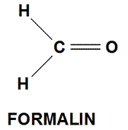
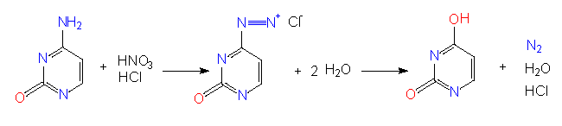
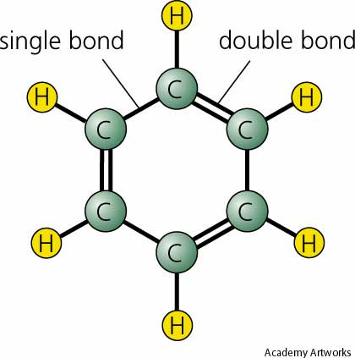
3. Chemical Mutagens
Some chemicals can induce mutations, e.g.:
Mustard gas
Formalin/formaldehyde
Nitrous acids – changes cytosine to uracil
Benzene
And many, many more! Including several in cigarette smoke

Slide 8
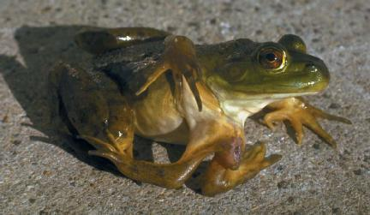
Chemical mutagens in the environment may be responsible for mutants such as this six legged frog.

Slide 9
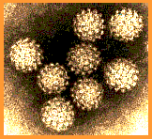
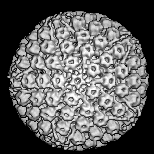
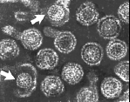
4. Viruses
Papilloma Viruses – Most cervical, vulvar and penile cancers are associated with types 16 and 18 Papilloma Viruses
Epstein-Barr Virus – implicated in causing Burkitt's lymphoma and other cancers
Hepatitis B Virus – implicated in causing liver cancer

Slide 10
More facts about mutations
Usually recessive
Most are harmful
Produce variety in a species, essential for evolution
TYPES
  Point (gene) mutations – affect small areas, often one nucleotide
  Chromosomal (block) mutations – rearrangements of blocks of genes within or between chromosomes
  Genomic mutations – change in the number of chromosomes. (Fewer or extra chromosome or sets of them).

Slide 11
And the good news…..
DNA repair
The cell does have a number of mechanisms that can recognise and repair damaged DNA.
These use the double-sided structure of DNA. So long as one side of the chain is intact it can be used to repair the other side.
Breaks in the DNA can also be fixed.

Slide 12
Point (gene) mutations
Substitutions – one nucleotide replaces another.
  May have no effect as the same amino acid is coded for.
  Mis-sense substitutions - a different a.a. is coded for. This may have little effect or a dramatic effect (e.g. sickle cell disease).
  Nonsense substitutions – a nonsense (stop) codon replaces one coding for an a.a. These produce a shorter polypeptide so are usually harmful

Slide 13
Point (gene) mutations (cont’d)
Deletion or insertion of a nucleotide.
One or more nucleotides may be added or removed. This may affect one or more amino acids
Frame shift mutations – occur if 1 or 2 nucleotides are inserted or deleted
  They displace all the bases of the genetic message following the mutation, thus changing every codon, resulting in a totally different polypeptide (or shorter chains).

Slide 14
An Analogy
Here is a simple message:
THEFATCATATETHEBIGRAT
Substitutions
THEFITCATATETHEBIGRAT
THEFATCOTATETHEBOGRAY
Deletion
THEFTCATATETHEBIGRAT
Insertion
THEFATCAXTATETHEBIGRAT

Slide 15
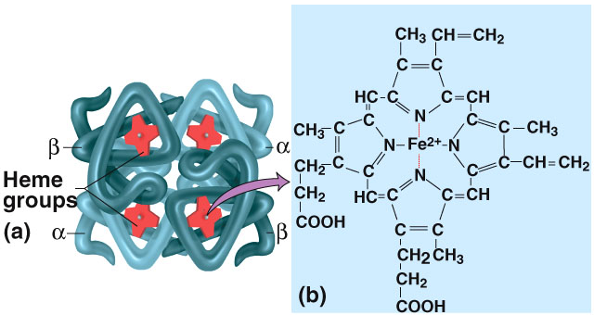
A point mutation example -
This is normal haemoglobin that carries oxygen in red blood cells.

Slide 16
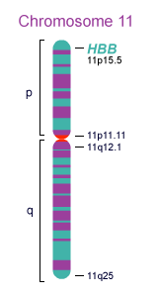




Sickle Cell Disease
Human chromosome number 11 carries a gene that codes for the beta chain of haemoglobin.
A point mutation exists which changes the 6th DNA triplet from CTC to CAC
This changes the mRNA codon from GAG to GUG

Slide 17
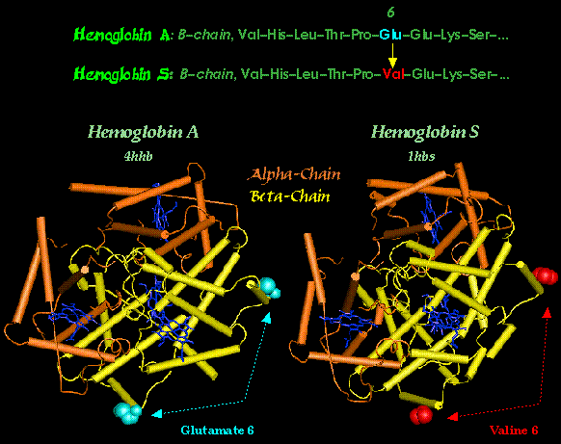
This mutation causes the substitution of the amino acid Glu (glutamic acid) by Val (valine).
It is therefore a mis-sense mutation.

Slide 18
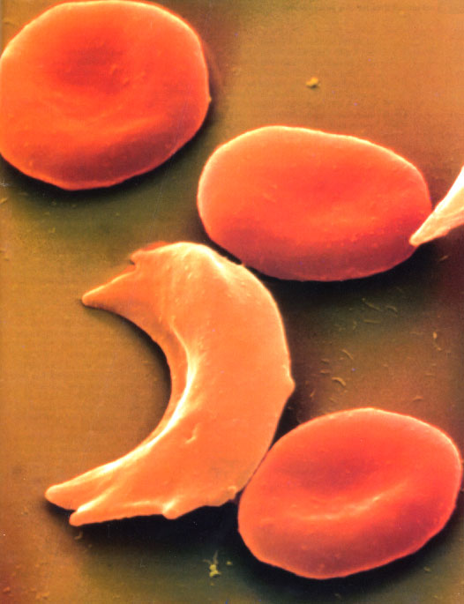
The mutant haemoglobin causes some blood cells to change to a sickle shape.

Slide 19
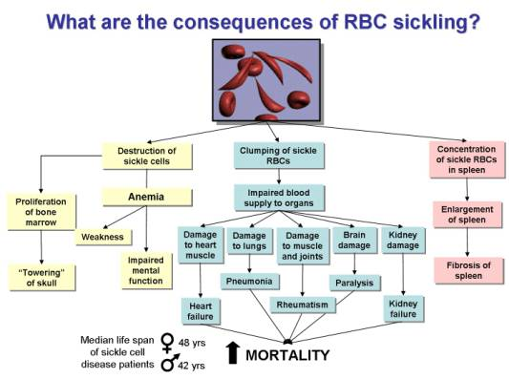
This change may have many effects on a person carrying two copies of the mutant gene

Slide 20
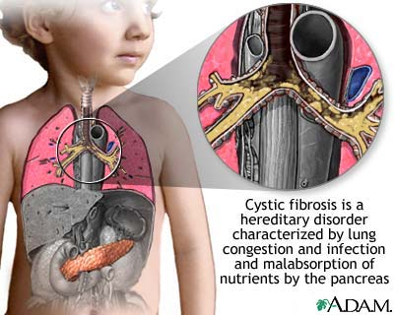
Deletion Mutation Example

Slide 21
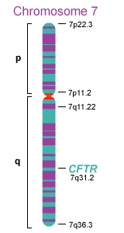
Cystic Fibrosis
Affects the CFTR gene on chromosome 7
A number of different mutations have been identified as causing this condition but about 70% of sufferers have 3 nucleotides deleted
This deletion causes loss of the amino acid phenylalanine located at position 508 in the protein

Slide 22
People who are homozygous for delta F508 mutation tend to have the most severe symptoms of cystic fibrosis due to critical loss of chloride ion transport.
This upsets the sodium and chloride ion balance needed to maintain the normal, thin mucus layer that is easily removed by cilia lining the lungs and other organs.
The sodium and chloride ion imbalance creates a thick, sticky mucus layer that cannot be removed by cilia and traps bacteria, resulting in chronic infections.

Slide 23
